Slide 1
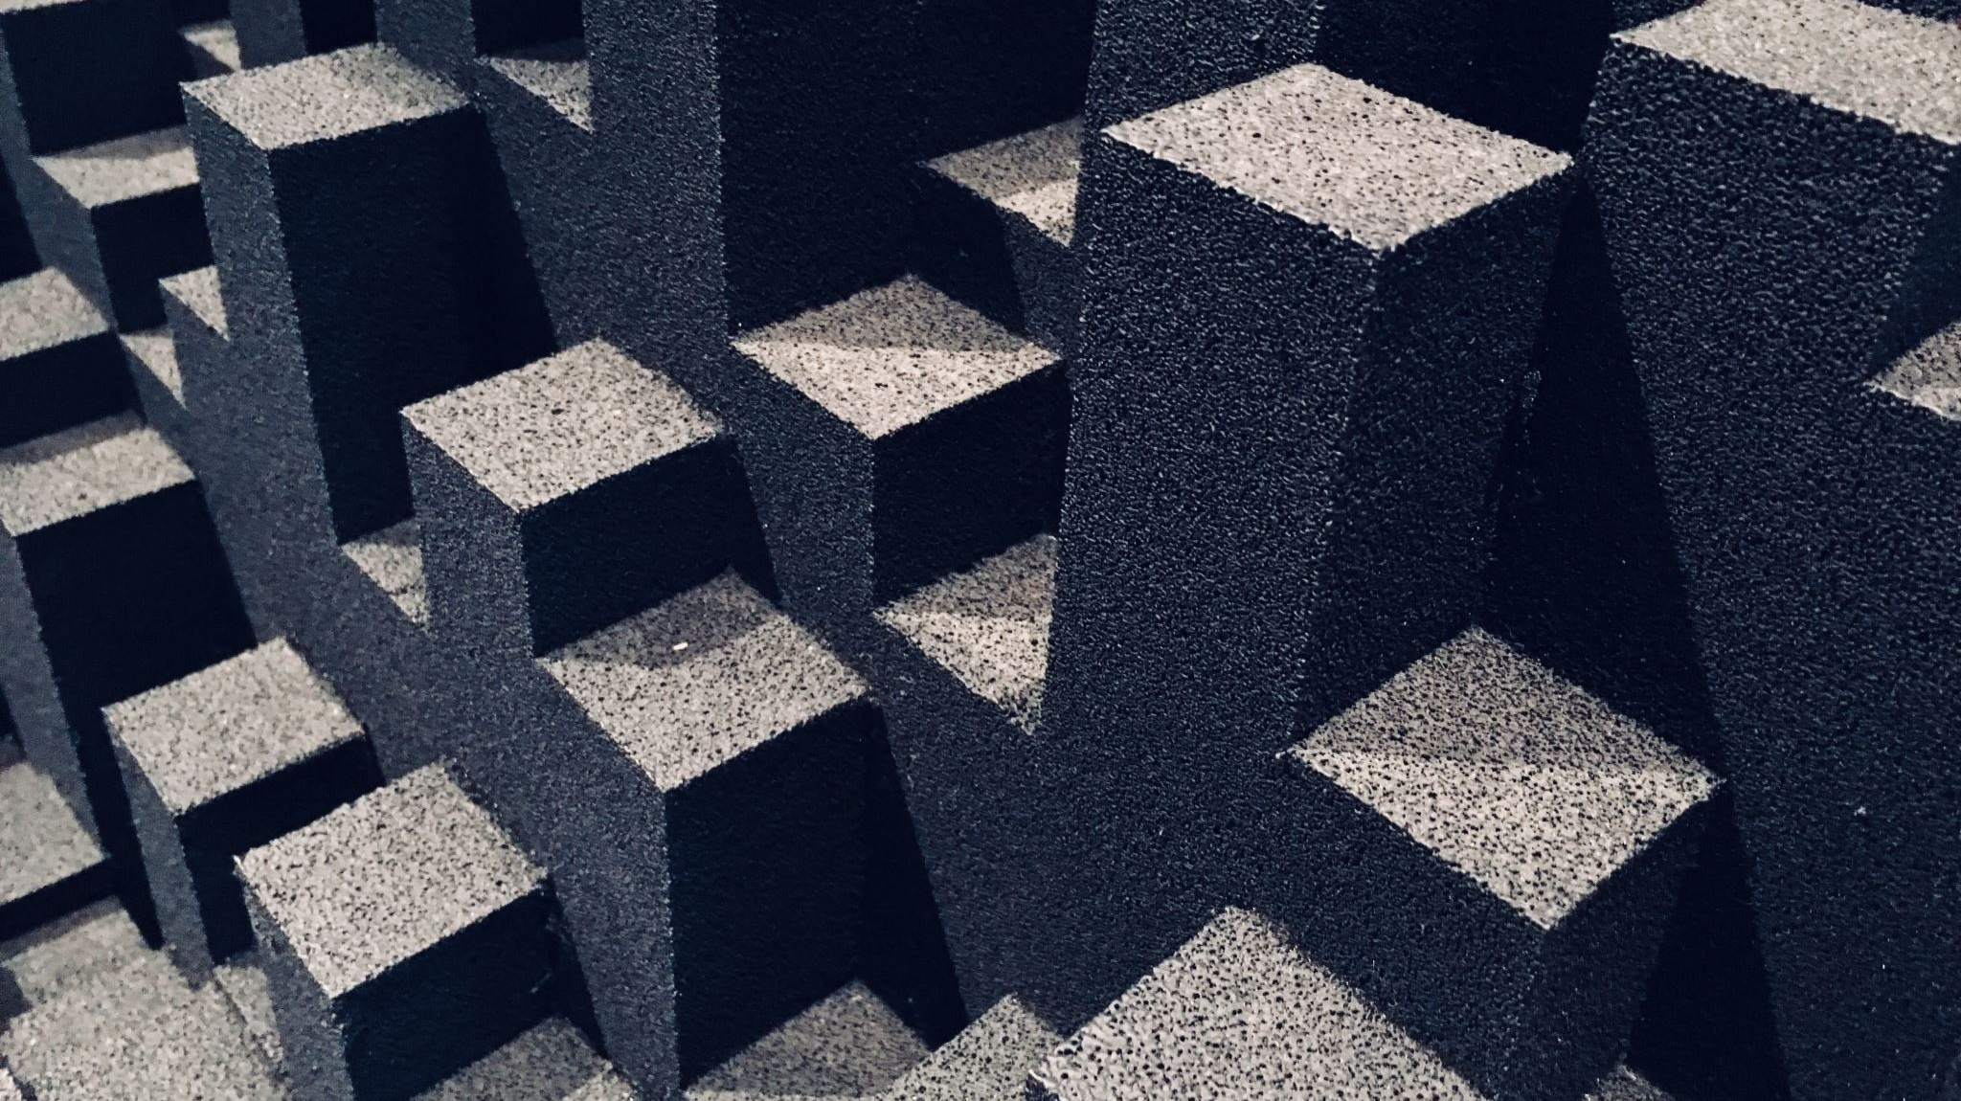
Continued Fractions
Danny O’Callaghan

Slide 2
Table of Contents
Timeline
What are continued fractions
Learning Example
Proper Notation of Continued Fractions
Finite Continued Fractions
Finite Continued Fractions Proof
Convergents
Irrational Continued Fractions
Periodic Irrational Continued Fractions
Nonperiodic Irrational Continued Fractions
Convergent Test
References

Slide 3
Timeline
300 BCE Euclid creates the Euclidean Algorithm, a critical part of continued fractions
499 Aryabata uses continued fractions for indeterminate equations in his magnum opus, Aryabhatiya
1572 Rafael Bombelli uses a method to extract square roots from equations in a similar manner to continued fractions
1613 Pierto Cataldi creates the first notation for continued fractions
1695 John Wallis introduces the term continued fraction in Opera Matematica
1737 Leonard Euler provided first comprehensive list of properties of continued fractions
1748 Leonard Euler proves all rational numbers are finite and all irrational numbers are infinite
1761 Johann Lambert proves pi is irrational via continued fractions
1770 Joseph-Louis Lagrange proves quadratic irrationals are periodic
1972 Bill Gosper creates arithmetic algorithms to find continued fractions

Slide 4
What are Continued Fractions
Continued Fractions is a way of expressing rational and irrational numbers via multiple-decked fractions

Slide 5
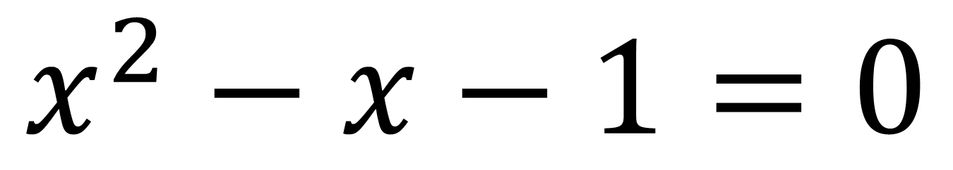
Example
$$x^{2}−x−1=0$$

Slide 6
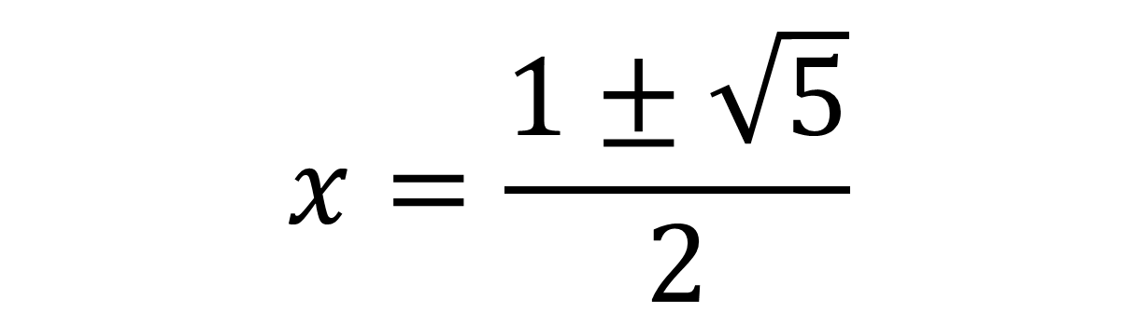
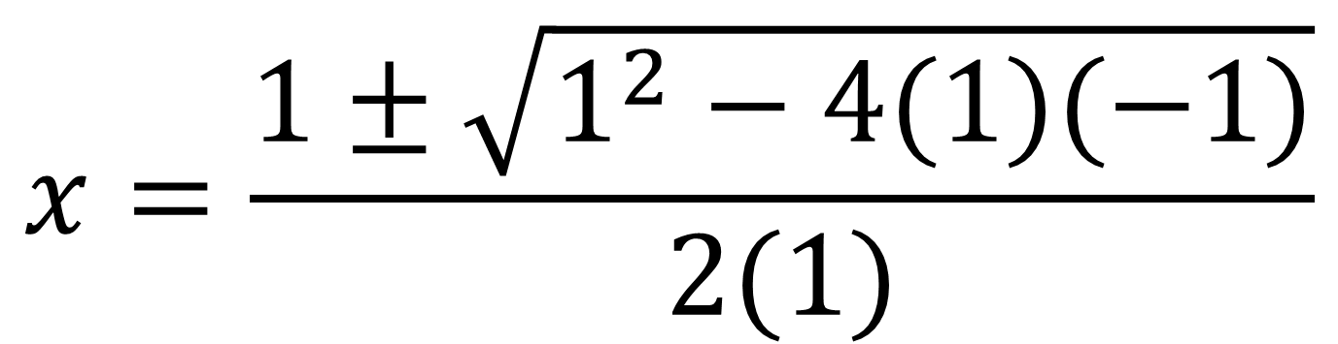
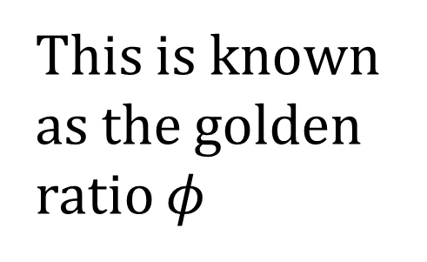
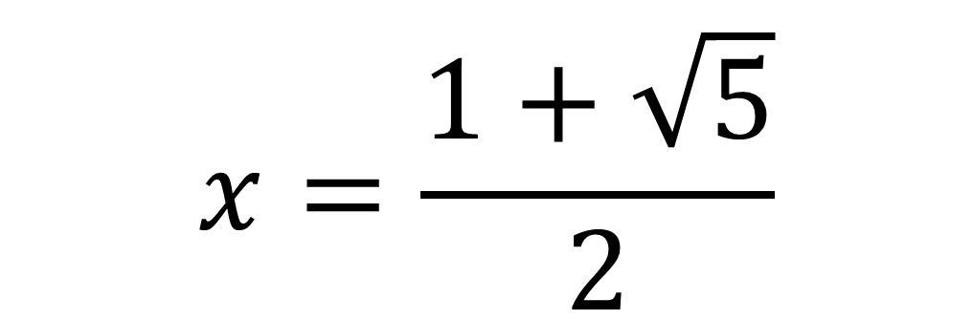
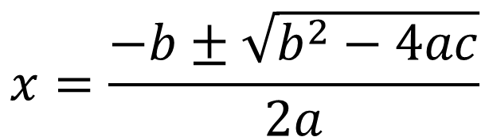
Typical way to Solve: Quadratic Equation
$$x=\frac{−b±\sqrt{b^{2}−4ac}}{2a}$$
$$x=\frac{1±\sqrt{1^{2}−4(1)(−1)}}{2(1)}$$
$$x=\frac{1±\sqrt{5}}{2}$$
$$x=\frac{1+\sqrt{5}}{2}$$
This is known as the golden ratio $φ$

Slide 7
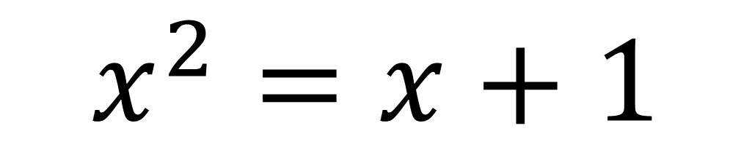
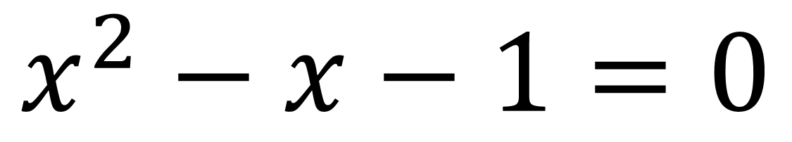
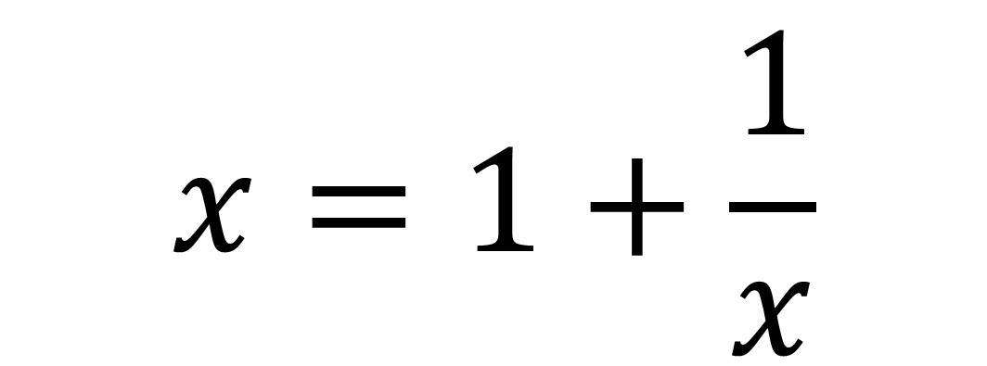
Learning Example
$$x^{2}−x−1=0$$
$$x^{2}=x+1$$
$$x=1+\frac{1}{x}$$

Slide 8
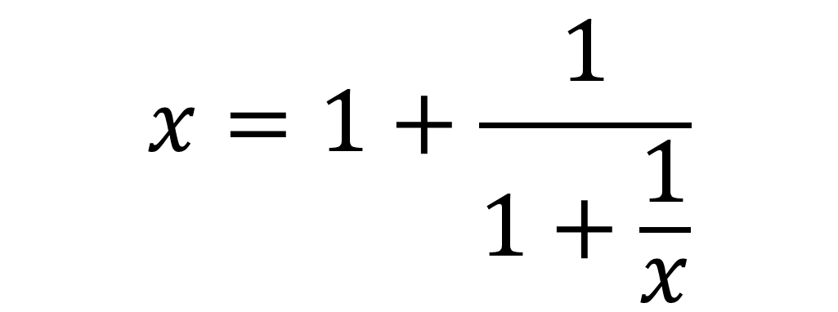
Learning Example
For the sake of the example, since x=1+1/x lets plug in x
$$x=1+\frac{1}{1+\frac{1}{x}}$$

Slide 9
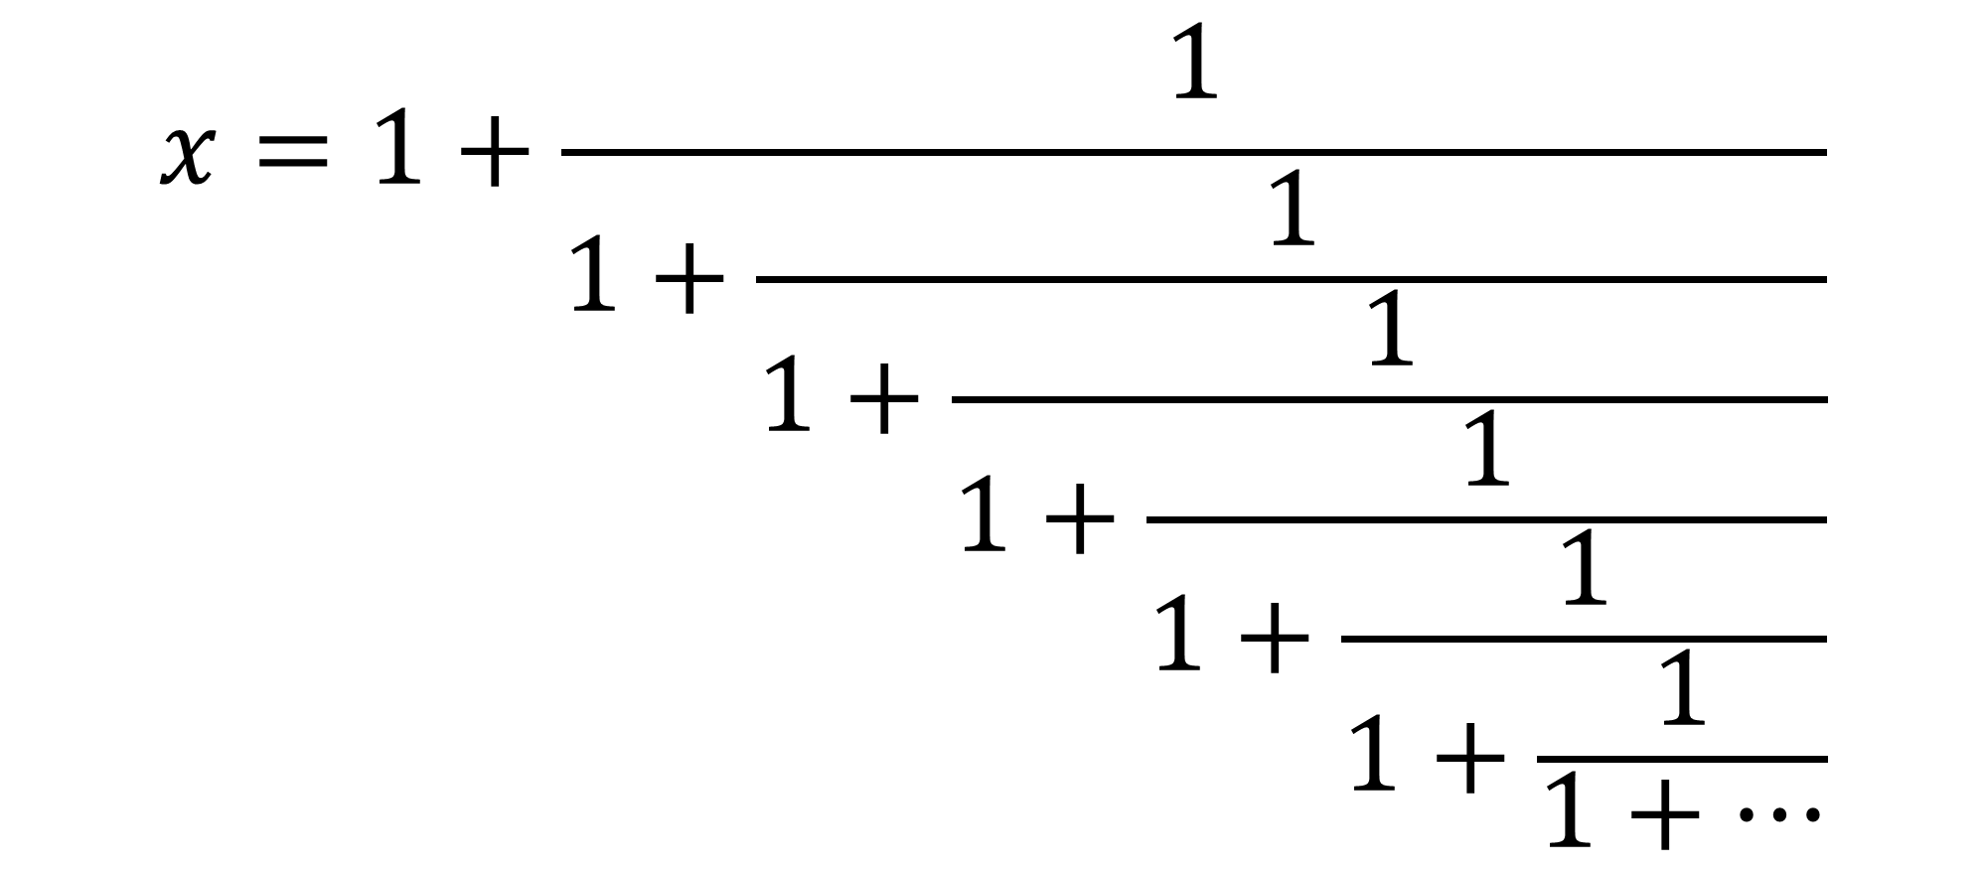
Learning Example
Keep plugging in x
$$x=1+\frac{1}{1+\frac{1}{1+\frac{1}{1+\frac{1}{1+\frac{1}{1+\frac{1}{1+…}}}}}}$$

Slide 10
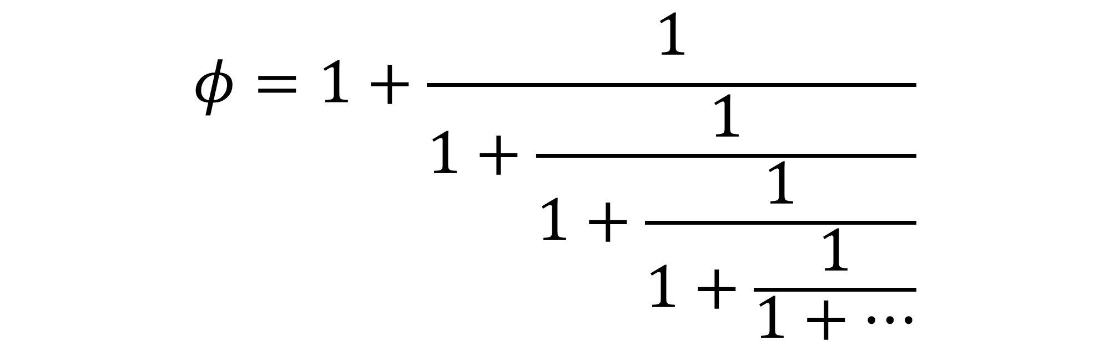
Learning Example Explanation
$$φ=1+\frac{1}{1+\frac{1}{1+\frac{1}{1+\frac{1}{1+…}}}}$$
Thus:

Slide 11
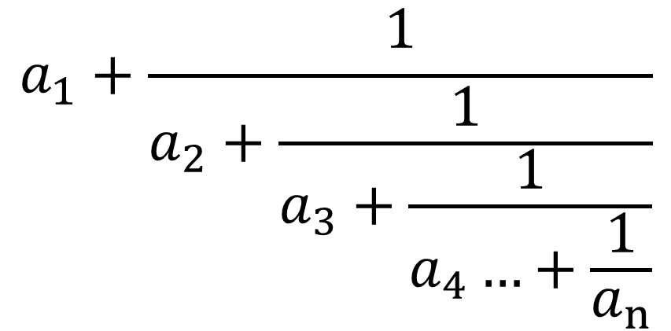
Proper Notation
Continued Fractions end up in the form
$$a_{1}+\frac{1}{a_{2}+\frac{1}{a_{3}+\frac{1}{a_{4}…+\frac{1}{a_{n}}}}}$$
Where n ϵ ℕ

Slide 12
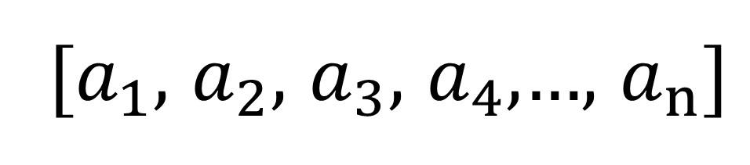
Proper Notation
Using the knowledge of an where n ϵ ℕ the proper notation is:
$$a_{1}+\frac{1}{a_{2}+\frac{1}{a_{3}+\frac{1}{a_{4}…+\frac{1}{a_{n}}}}}$$
=
[$a_{1}$, $a_{2}$, $a_{3}$, $a_{4}$,…, $a_{n}]$

Slide 13
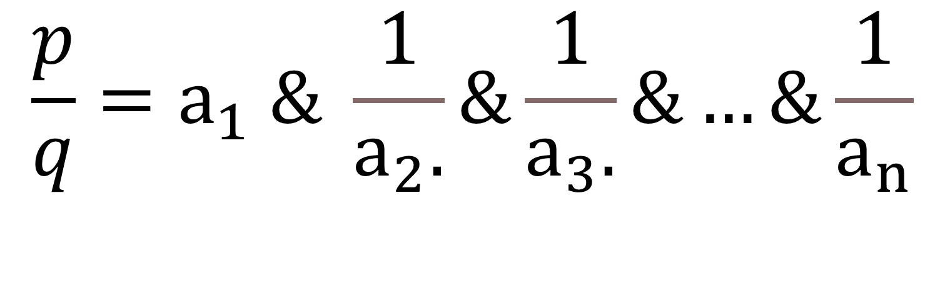
Pierto Cataldi Notation
$$\frac{p}{q}=a_{1} \& \frac{1}{a_{2}.}\&\frac{1}{a_{3}.}\&…\&\frac{1}{a_{n}}$$

Slide 14
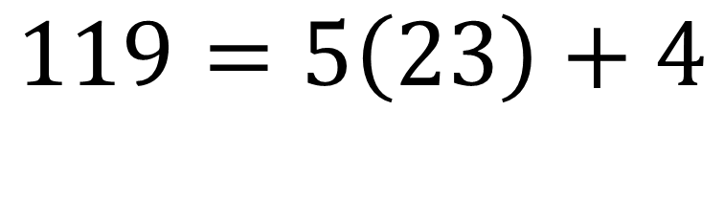
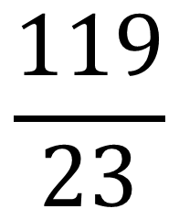
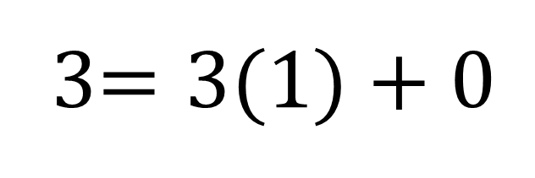


Finite Example
$$\frac{119}{23}$$
Euclidean Algorithm is a great approach for problems like this
$$\begin{matrix}119=5\left(23\right)+4 \\ \end{matrix}$$
$$23=5\left(4\right)+3$$
4$=1\left(3\right)+1$
3$=3(1)+0$
END

Slide 15
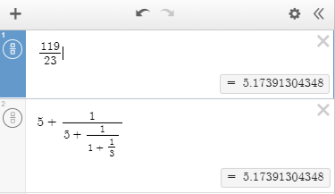
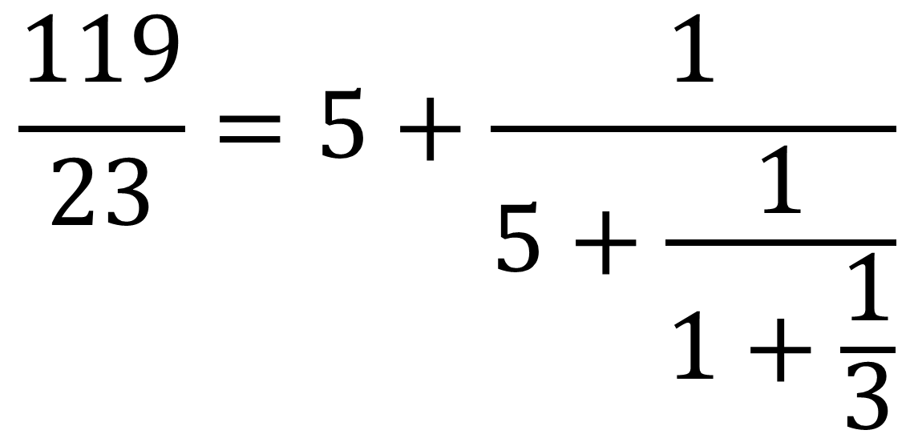
Finite Example
$$\frac{119}{23}$$
Calculator Proof
$$\frac{119}{23}=5+\frac{1}{5+\frac{1}{1+\frac{1}{3}}}$$

Slide 16

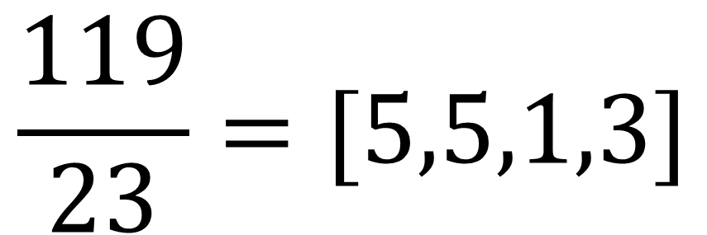
In Proper Notation
$$\frac{119}{23}=[5,5,1,3]$$
$$φ=[1,1,1,1,1,1,1,1,…]$$

Slide 17
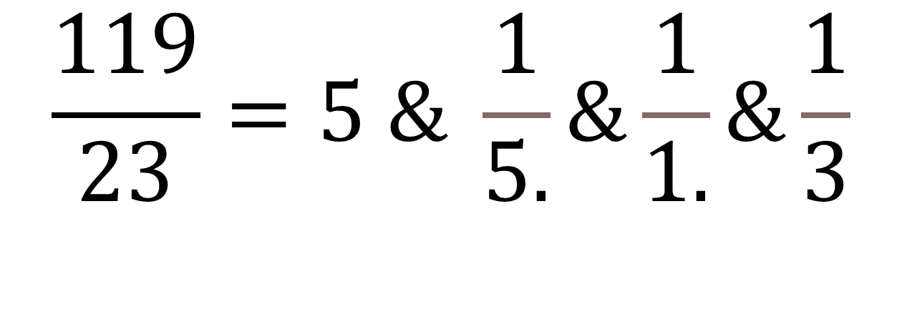
Pierto Cataldi Notation
$$\frac{119}{23}=5 \& \frac{1}{5.}\&\frac{1}{1.}\&\frac{1}{3}$$

Slide 18
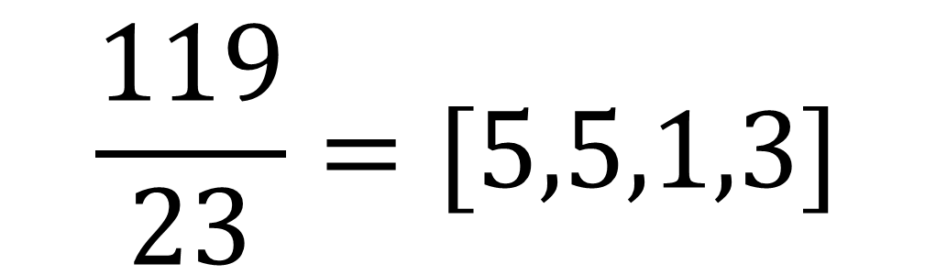
Notice: Rational Continued Fractions are FINITE
$$\frac{119}{23}=[5,5,1,3]$$
Is this true for all rational numbers?
Yes, this was proven by Leonard Euler

Slide 19
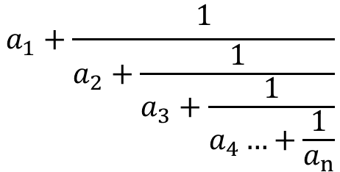
Proof Finite Continued Fractions are Rational
Theorem: Any Finite simple continued fraction represents a rational number
Proof:
Let a_{n} ϵℤ where ∀n≥2 a_{n}≠0
$$a_{1}+\frac{1}{a_{2}+\frac{1}{a_{3}+\frac{1}{a_{4}…+\frac{1}{a_{n}}}}}$$
Using a_{n} lets create the equation:
Since this equation is finite, we will eventually reach an ending point where there is a fraction.
This fraction has a numerator that is an integer, and a denominator is an integer that cannot be 0.
This is identical to the definition of the rational numbers we use in class
$$ℚ=\left\{\frac{p}{q} | p,qϵℤ and q≠0\right\}$$

Slide 20
The Converse
Theorem: Any Rational Number can be expressed as a finite continued fraction
The converse also proves true, relying heavily on the properties of the Euclidean algorithm and displaying them as a sequence
This allows us to use the monotone convergence theorem, to prove the sequence eventually converges
Since the sequence converges, the rational number ends up being expressed as a continued fraction

Slide 21
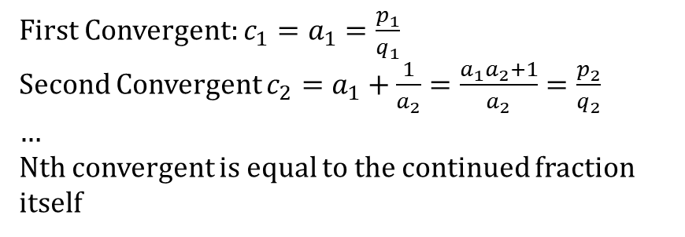
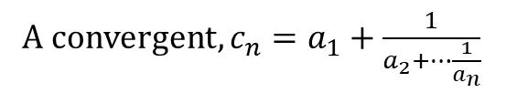
Convergents
Convergents are a method of expressing only part of a continued fraction
This will be very helpful when expressing some irrational numbers, but easier explained with Rational ones
A convergent, $c_{n}=a_{1}+\frac{1}{a_{2}+…\frac{1}{a_{n}}}$
Convergents are called the nth convergent,
First Convergent: $c_{1}=a_{1}=\frac{p_{1}}{q_{1}}$
Second Convergent $c_{2}=a_{1}+\frac{1}{a_{2}}=\frac{a_{1}a_{2}+1}{a_{2}}=\frac{p_{2}}{q_{2}}$
…
Nth convergent is equal to the continued fraction itself

Slide 22
Irrational Numbers are Infinite
Although we will not prove it now, Leonard Euler was also able to prove that irrational numbers are built up by infinite continued fractions.
This proof was very helpful towards mathematics as a whole, because it is what allowed mathematicians to prove e and π are irrational
Euler used this rule to prove that e was irrational
Johann Lambert used this rule to prove π was irrational

Slide 23
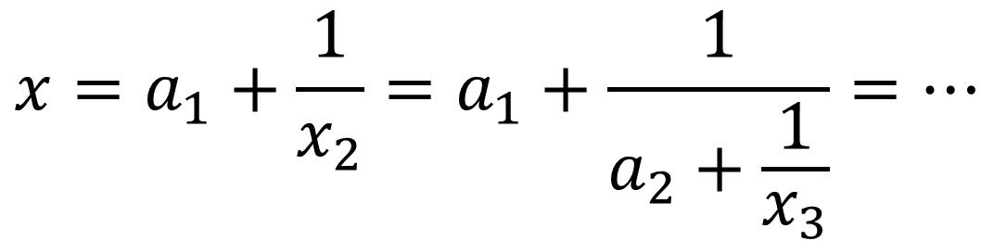

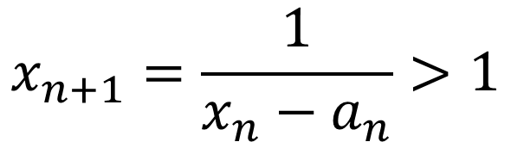
Irrational Continued Fractions (Procedure)
The best way to find an infinite continued fraction is by using the following formula, used by Bill Gosper
$$x_{n}=a_{n}+\frac{1}{x_{n+1}}$$
Where x_{n} is an irrational number and a_{n} is the greatest integer less than x_{n}.
x_{n+1}>1 , a_{n}≥1
$$x_{n+1}=\frac{1}{x_{n}−a_{n}}>1$$
We then know,
$$x=a_{1}+\frac{1}{x_{2}}=a_{1}+\frac{1}{a_{2}+\frac{1}{x_{3}}}=…$$

Slide 24
Quadratic Irrationals are Periodic
As first proven by Lagrange in 1768, Lagrange found that quadratic irrationals are periodic
This means that at some point in the continued fraction of quadratic irrational numbers, the numbers will start repeating themselves
For example, earlier we found the golden ratio to be repeating 1s

Slide 25
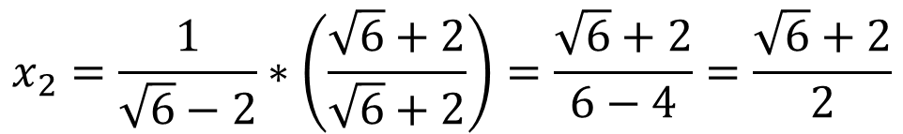

Irrational Continued Fractions Example
$$\sqrt{6}$$
Step 1: find a₁
The Floor of square root of 6 is 2
Thus a₁=2
$$x_{2}=\frac{1}{\sqrt{6}−2}∗\left(\frac{\sqrt{6}+2}{\sqrt{6}+2}\right)=\frac{\sqrt{6}+2}{6−4}=\frac{\sqrt{6}+2}{2}$$
What is a₂? The floor of this number is 2
Thus, a₂=2
What is a₃? The Floor of this is 4. Thus, a₃=4
$x_{3}=\frac{1}{\frac{\sqrt{6}+2}{2}−2}=\frac{1}{\frac{\sqrt{6}+2}{2}−\frac{4}{2}}=\frac{1}{\frac{\sqrt{6}−2}{2}}=\frac{2}{\sqrt{6}−2}∗\left(\frac{\sqrt{6}+2}{\sqrt{6}+2}\right)=\frac{4+2\sqrt{6}}{2}$=2+ $\sqrt{6}$

Slide 26
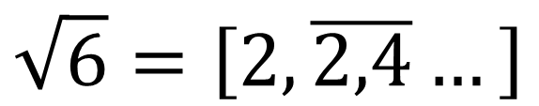
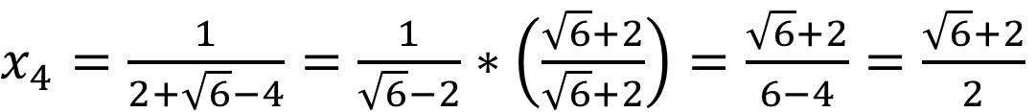
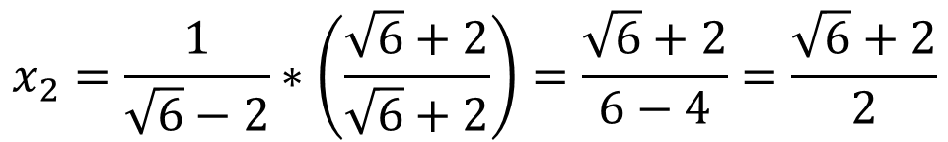
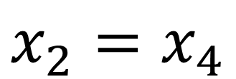
Irrational Continued Fractions Example
$x_{4}=\frac{1}{2+\sqrt{6}−4}=$ $\frac{1}{\sqrt{6}−2}∗\left(\frac{\sqrt{6}+2}{\sqrt{6}+2}\right)=\frac{\sqrt{6}+2}{6−4}=\frac{\sqrt{6}+2}{2}$
NOTICE
$$x_{2}=\frac{1}{\sqrt{6}−2}∗\left(\frac{\sqrt{6}+2}{\sqrt{6}+2}\right)=\frac{\sqrt{6}+2}{6−4}=\frac{\sqrt{6}+2}{2}$$
$$x_{2}=x_{4}$$
Since x₂=x₄ we know a₂ and a₃ are repeating Thus,
$$\sqrt{6}=\left[2,\overline{2,4}…\right]$$

Slide 27
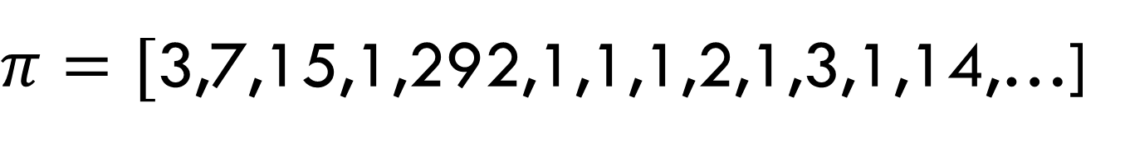
Nonperiodic Irrational Continued Fractions
Unlike quadratics, numbers like π and e do not have such an easy way of calculating, nor do they eventually become periodic.
$π=[$3,7,15,1,292,1,1,1,2,1,3,1,14,…]
$$e^{1}=[2,1,2,1,1,4,1,1,6,1,1,8,…]$$

Slide 28

Convergents Test
Theorem: Each Convergent is nearer to the value of an infinite simple continued fraction than is the preceding convergent
The proof ends up using properties of convergents and absolute values to end up with this result
$$\left|x−c_{n}\right|<|x−c_{n−1}|$$

Slide 29
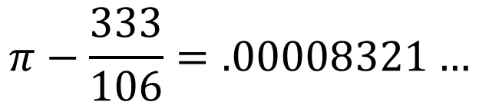

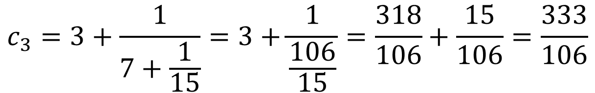
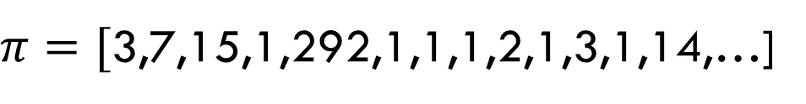
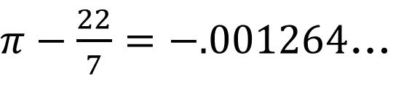
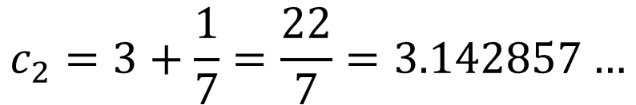


Convergents Test application
Recall
$π=[$3,7,15,1,292,1,1,1,2,1,3,1,14,…]
We know
$$π=3.14159265358979…$$
$$c_{1}=3$$
$$π−3=\text{0.14159265359}\text{...}$$
$$c_{2}=3+\frac{1}{7}=\frac{22}{7}=3.142857…$$
$π−\frac{22}{7}=−.001264$…
$$c_{3}=3+\frac{1}{7+\frac{1}{15}}=3+\frac{1}{\frac{106}{15}}=\frac{318}{106}+\frac{15}{106}=\frac{333}{106}$$
$$π−\frac{333}{106}=.00008321…$$
What do the signs mean?
Positive result means π was under-represented by the continued fraction
Negative result means π was over-represented by the continued fraction

Slide 30

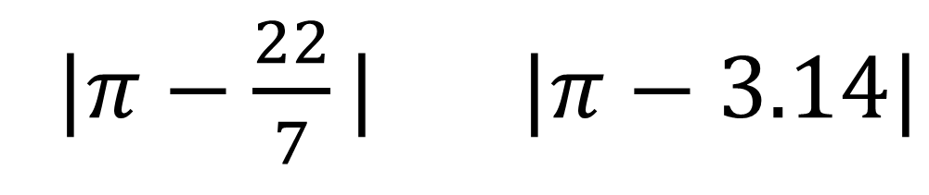
Which is a better approximation for Pi?
|$π−\frac{22}{7}| |π−3.14|$
$$<$$

Slide 31
References (APA)
Brazas, J. (2021). Operations on Sets. Personal Collection of J. Brazas, West Chester University of Pennsylvania, West Chester PA.
https://d2l.wcupa.edu/d2l/le/content/3053732/viewContent/24417308/View
Cohn, H. (2006). A Short Proof of the Simple Continued Fraction Expansion of 𝑒. The American Mathematical Monthly, 113(1), 57. https://doi.org/10.2307/27641837
Lange, L. J. (1999). An Elegant Continued Fraction for π. The American Mathematical Monthly, 106(5), 456–458. https://doi.org/10.1080/00029890.1999.12005070
Niven, I. (2005). Irrational Numbers: Vol. Pbk. edition. Mathematical Association of America.
https://search.ebscohost.com/login.aspx?direct=true&AuthType=sso&db=e000xna&AN=760883&site=eds-live&scope=site
Olds, C. D. (2012). Continued Fractions. Mathematical Association of America. https://search.ebscohost.com/login.aspx?direct=true&AuthType=sso&db=e000xna&AN=450353&site=eds-live&scope=site
Wikipedia contributors. (2022, February 21). Continued fraction. In Wikipedia, The Free Encyclopedia. Retrieved 23:25, March 27, 2022,

